Slide 1
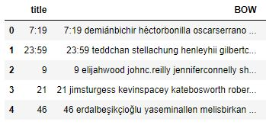
NETFLIX MOVIE RECOMMENDATION USING COSINE SIMILARITY
Preprocessed Data of Netflix titles csv
The BOW column contains combination of title and description column in lower case.
Two columns are combined to make search more efficient based on title as well as description column

Slide 2
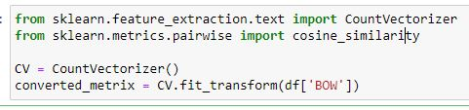
Cosine similarity model is used for training the data and getting recommendations.
Cosine Similarity calculates the similarity between two things.
After computing the similarity, we further use those computed values for recommendations.

Slide 3
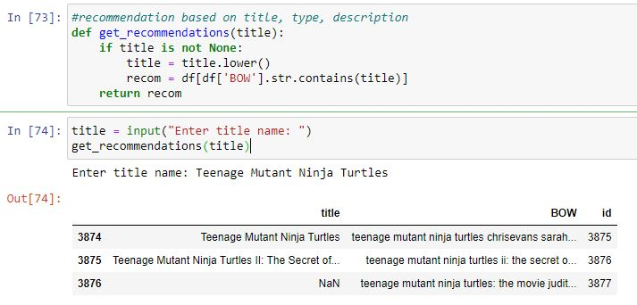
We pass the title and get all the recommendations that matches the title
After taking the input from the user the input is converted to lower case to make search more efficient.
Each row of BOW checks if the input string is present in that column and returns matching rows of that title.

Slide 4
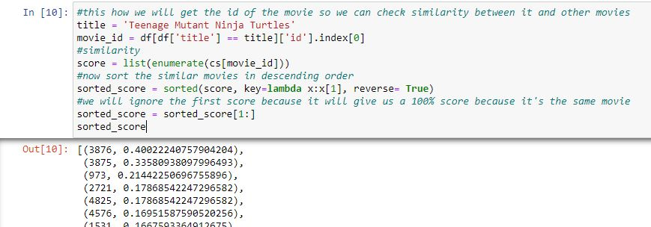
Once the data is trained, we pass the title to the model and will get all the similar movie ids related to the title and the accuracy of movie ids with respect to the title given as an input.

Slide 5
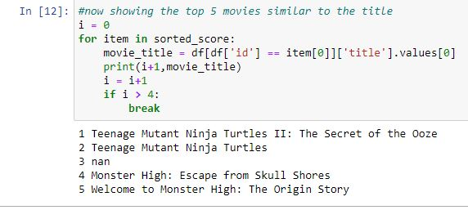
After getting similar movie ids for the title, we now get the movie titles for the recommended ids.

